Slide 1
— course overview — 18.06: Linear Algebra
Prof. Steven Johnson,
MIT Applied Math, Physics
Spring 2022
all materials: https://github.com/stevengj/1806
pset submission/grades/announcements only: MIT Canvas
Textbook: Strang, Introduction to Linear Algebra, 5th edition
+ supplementary notes

Slide 2
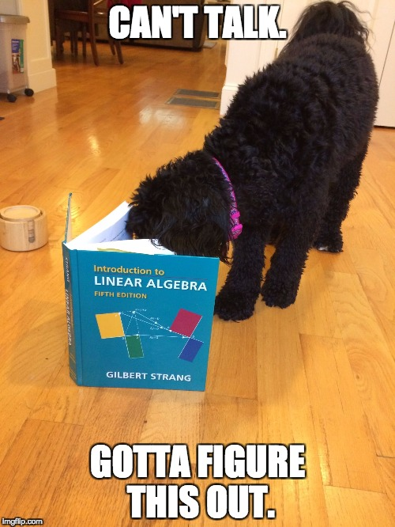
The textbook
Gil Strang, Introduction to Linear Algebra, 5th edition
Significant but incomplete overlap with Strang’s OCW video lectures: these are a useful supplement but not a replacement for my lectures!
Linear algebra is a vast subject, no single semester (or single book) covers all of it …

Slide 3
Administrative Details
Lectures MWF11, 10-250 — video recording & notes links posted to github
Tuesday recitations, Wed/Thurs office hours — use Canvas to switch sections
Weekly psets, due Fridays 11am. Electronic submission through Canvas
— lowest pset score will be dropped, anything else requires S3 + Prof. J.
— short pset 0 posted today, due this Friday 2/4
Grading: homework 15%, 3 exams 45% (2/25, 4/1, & 5/6), & final exam 40%
Collaboration policy: talk to anyone you want, read anything you want, but:
• Make an effort on a problem before collaborating.
• Write up your solutions independently (from “blank sheet of paper”).
• List your collaborators and external sources (not course materials).
18.06 piazza.com discussion forum: https://piazza.com/class/kykapaoapky33j
Problem-set partnering: psetpartners.mit.edu
Tutoring: Math Learning Center, also TSR²

Slide 4
Syllabus and Calendar
Significant overlap with Strang’s OCW video lectures: these are a useful supplement but not a replacement for attending lecture. Likely topics:
Exam 1: Friday 2/25. Matrices, Elimination, LU factorization, nullspaces and other subspaces, bases and dimensions, vector spaces, complexity. (Book: 1–3.5, 11.1)
Exam 2: Friday 4/1. Orthogonality, projections, least-squares, QR, Gram–Schmidt, orthogonal functions, determinants, infinite dimensional vector spaces (Book: 1–5, 10.5). Concentrating on material since exam 1, but linear algebra is cumulative!
Exam 3: Friday 5/6. Eigenvectors, determinants, similar matrices, Markov matrices, ODEs, symmetric matrices, definite matrices, matrices from graphs and engineering. (Book: 1–7, 10.1–3.)
Other possible topics: defective matrices, SVD and principal-components analysis, sparse matrices and iterative methods, complex matrices, linear operators on functions, matrix calculus & optimization / root-finding.
Final exam: all of the above.
Before each exam, a definitive list of topics will be announced, along with a review session.

Slide 5
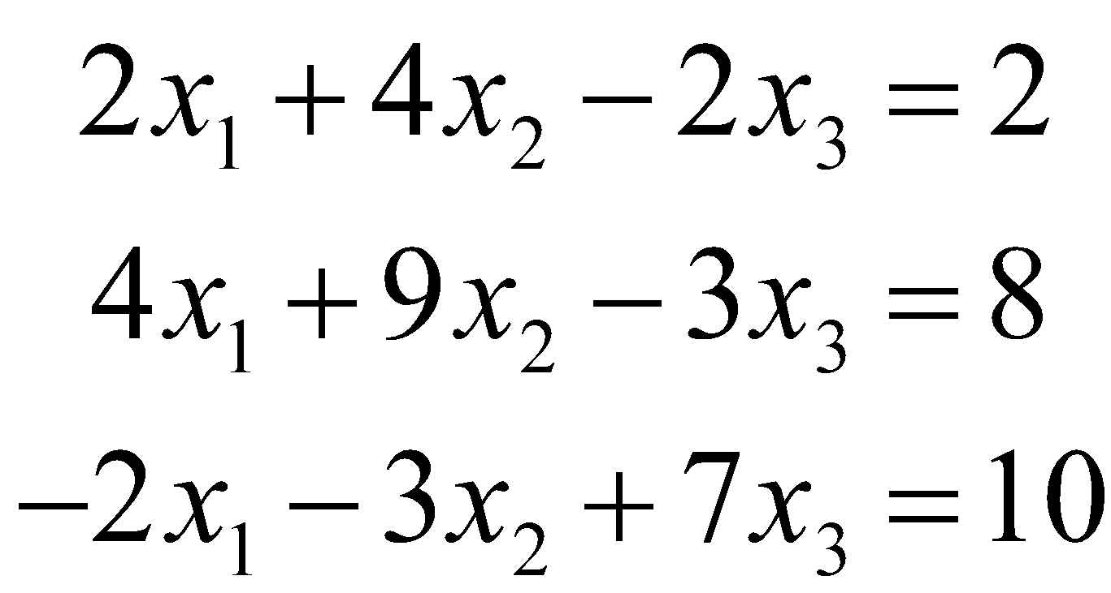
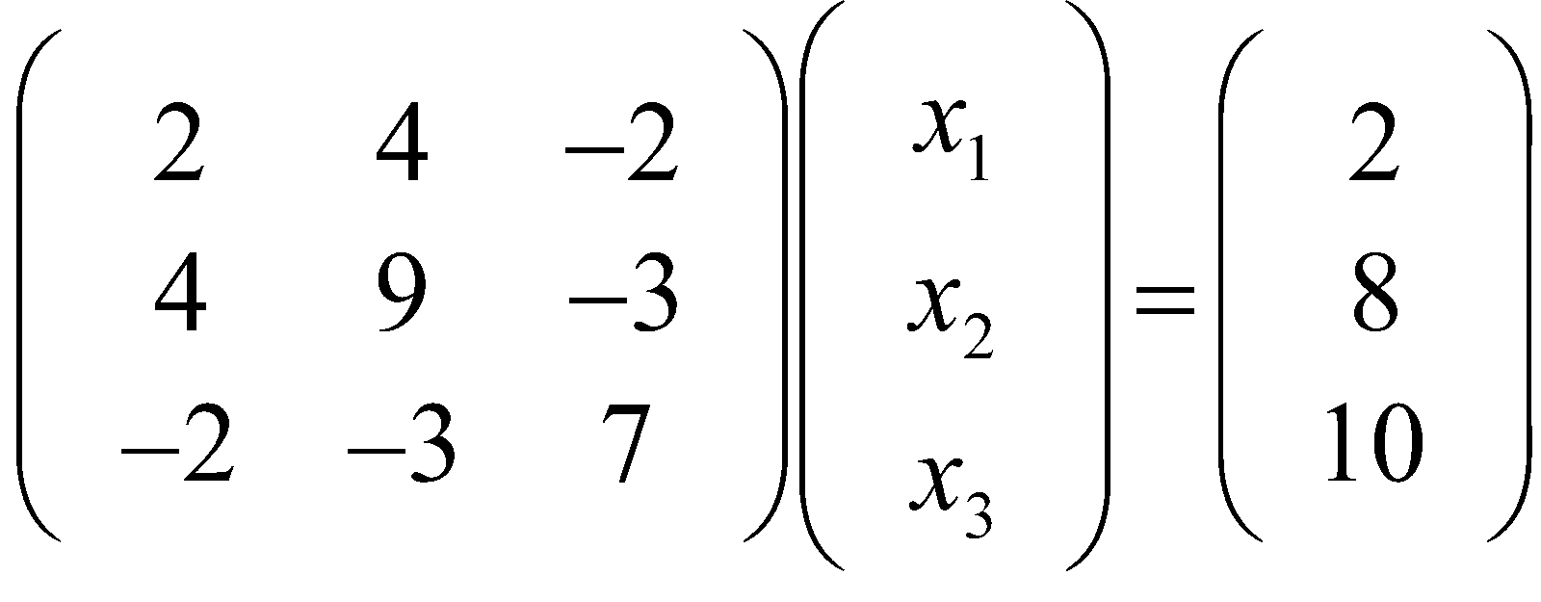
What is 18.06 about?
High school:
3 “linear” equations
(only ± and × constants)
in 3 unknowns
Method: eliminate unknowns one at a time.
take “dot products” of rows × columns
Equivalent matrix problem
Ax = b
Ax is a “linear operation:”
A(x+y) = Ax + Ay
A(3x) = 3Ax
A
x
b
matrix of
coefficients
vector of
unknowns
vector of
right-hand sides

Slide 6
What is 18.06 about?
Linear system of equations,
in matrix form
Ax = b
A
x
b
Will we learn faster methods to solve this? No. (Except if A is special.) The standard “Gaussian elimination” (and “LU factorization”) matrix methods are just a slightly more organized version of the high-school algebra elimination technique.
Will we get better at doing these calculations by hand? Maybe, but who cares? Nowadays, all important matrix calculations are done by computers.
Will we learn more about the computer algorithms? A little. But mostly the techniques for “serious” numerical linear-algebra are topics for another course (e.g. 18.335).

Slide 7
How do we think about linear systems? (imagine someone gives you a 10⁶×10⁶ matrix)
All the formulas for 2×2 and 3×3 matrices would fit on one piece of paper. They aren’t the reason why linear algebra is important (as a class or a field of study).
Large problems are solved by computers, but must be understood by human beings. (And we need to give computers the right tasks!)
Understand non-square problems: #equations > #unknowns or vice versa
Break up matrices into simpler pieces
Factorize matrices into products of simpler matrices: A=LU (triangular: Gauss), A=QR (orthogonal/triangular), A=XΛX^{–1} (diagonal: eigenvecs/vals), A=UΣV* (orthogonal/diagonal: SVD), …
Submatrices (matrices of matrices).
Break up vectors into simpler pieces: subspaces and basis choices.
Algebraic manipulations to turn harder/unfamiliar problems (e.g. minimization or differential equations) into simpler/familiar ones: algebra on whole matrices at once

Slide 8
Don’t expect a lot of “turn the crank” problems
on psets or exams of the form
“solve this system of equations.”
… we will turn it upside-down, give you the answer and ask the question, ask about properties of the solution from partial information, give you a factorization and ask how to use it … the general goal is to require you to understand the crank rather than just turn it.
Fundamentally more abstract than 18.01–18.03!

Slide 9
Where do big matrices come from? Lots of examples in many fields, but here are a couple that are relatively easy to understand…

Slide 10
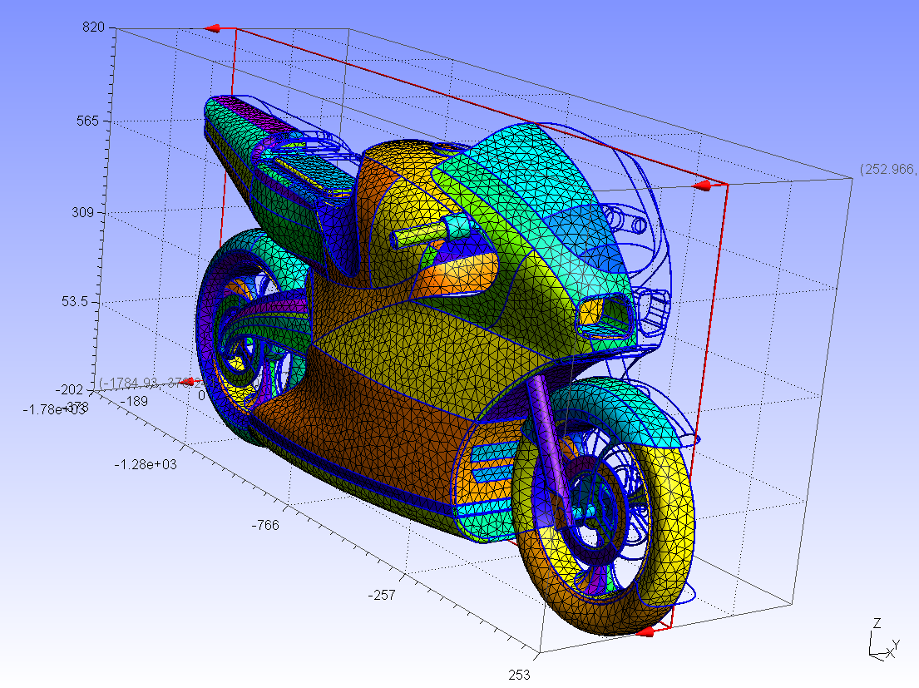
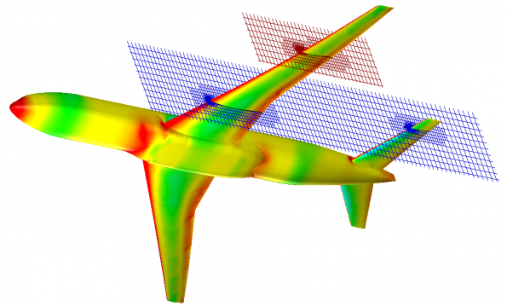
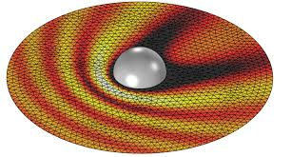
Engineering & Scientific Modeling [ 18.303, 18.330, 6.336, 6.339, … ]
http://gmsh.info/
Unknown functions
(fluid flow, mechanical stress,
electromagnetic fields, …) approximated by values on a discrete mesh/grid
e.g. 100x100x100 grid
= 10⁶ unknowns!
http://www.electronics-eetimes.com/
comsol.com

Slide 11
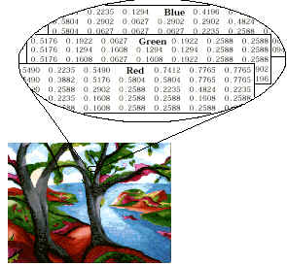
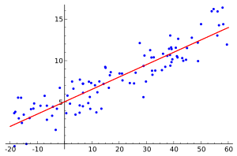
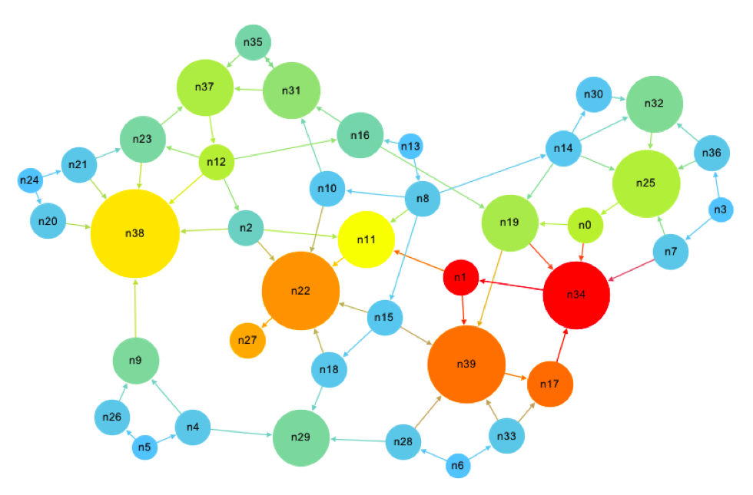
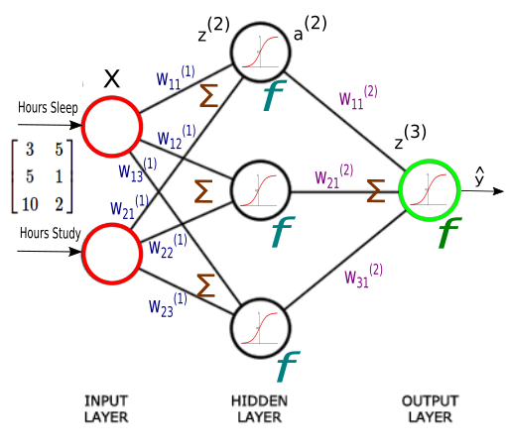
Data analysis and Machine Learning
Regression:
(curve fitting)
[ Mathworks ]
[ wikipedia ]
Image processing:
images are just matrices of numbers
(red/green/blue intensity)
Google “page rank” problem
(also for gene networks etc.)
Determine the “most important”
web pages just from how they link.
matrix = (# web pages) × (# web pages)
(entry = 1 if they link, 0 otherwise)
[ computationalculture.net ]
Machine Learning
(6.036 requires 18.06!)

Slide 12
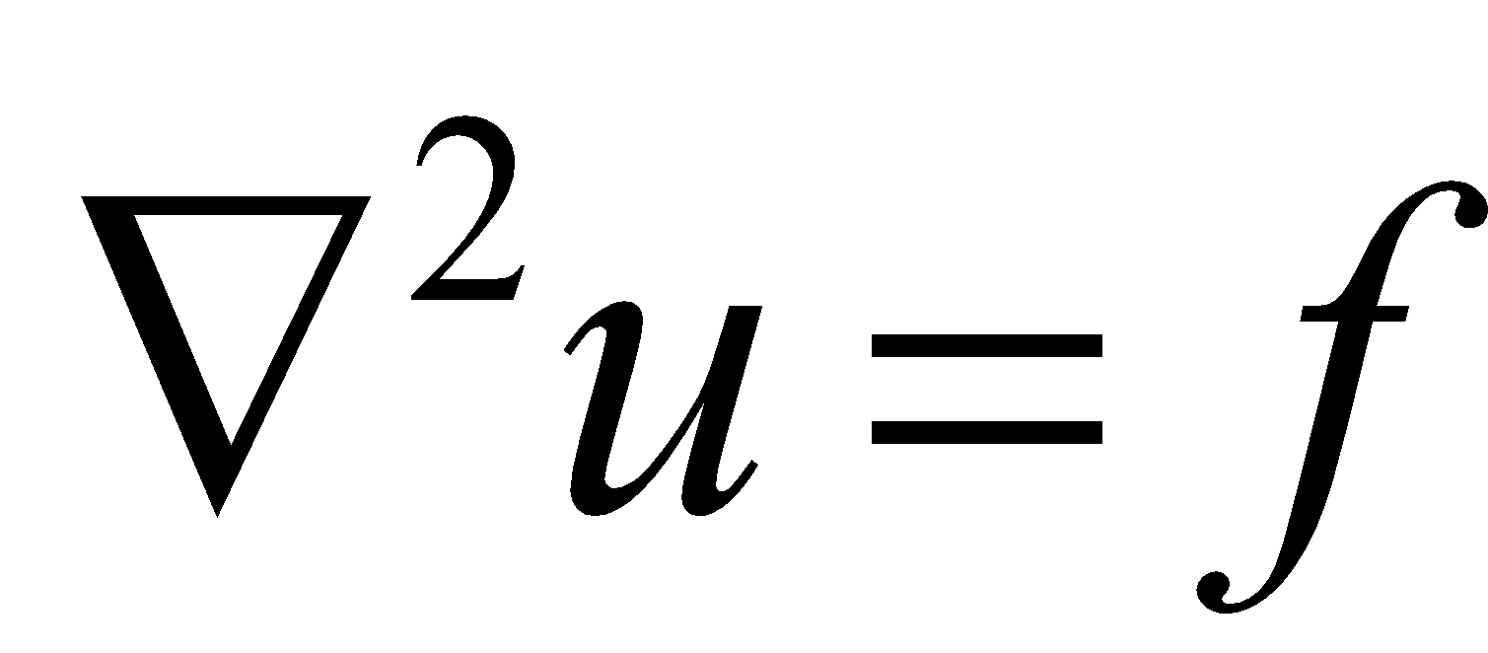
Not just matrices of numbers
There are lots of surprising and important generalizations of the ideas in linear algebra.
Example: Instead of vectors with a finite number of unknowns, similar ideas apply to functions with an infinite number of unknowns.
Instead of matrices multiplying vectors, we can think about linear operators on functions
Poisson’s equation
(e.g. 18.303, 18.152)
“A”
“x”
“b”
linear
operator
∇²
unknown
function
u(x,y,z)
right-hand side
f(x,y,z)

Slide 13
18.06 vs. 18.700
“applied” vs. “pure” math
few proofs vs. formal proofs expected
(deduce patterns (definitions to
from examples, lemmas to theorems
informal arguments) … training in proof writing)
more applications vs. more theorems
more concrete vs. more abstract
some computers vs. only pencil-and-paper

Slide 14
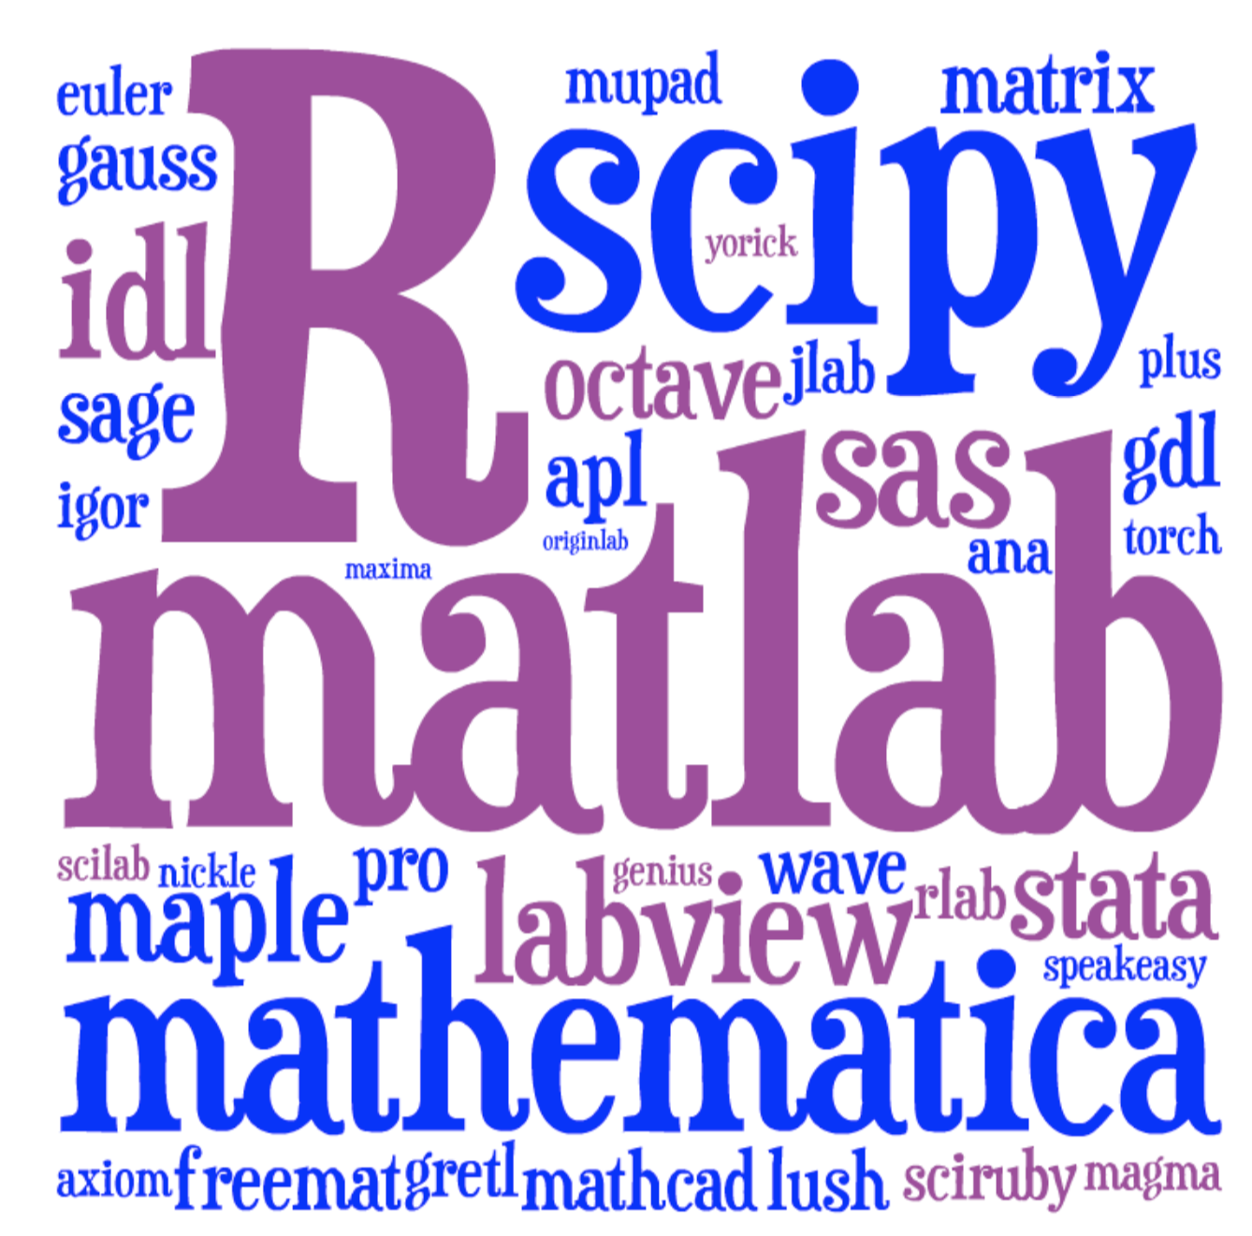

Computer software
This semester: a new-ish (2012) language
that scales better to real problems.
Lots of choices:
julialang.org
No programming required for 18.06,
just a “glorified calculator” to turn the crank.
Only on psets, not exams
Install it on your computer (preferred) or use it online — see tutorial link on github
Optional tutorial: Wed 5pm via Zoom
[ image: Viral Shah ]

Slide 15

18.06 vs. 18.700
furry friend vs. no furry friends?
“Cookie”
5-year old mini labradoodle

Slide 16
18.06 warm-up material
We don’t want to think of matrices as just “bags of numbers” that we push around with some algorithms. We want to think algebraically and geometrically.
Many of the algebraic rules (for scalar numbers) you have used for years no longer work (for vectors and matrices)! Blindly pushing symbols around will mostly lead to nonsense.
Pro tip: Always think of the shapes of matrices and vectors and keep track of the order of operations
— you can only add/multiply things if their shapes are compatible
— AB ≠ BA, and re-ordering is likely nonsensical for non-square objects.

Slide 17
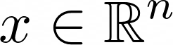
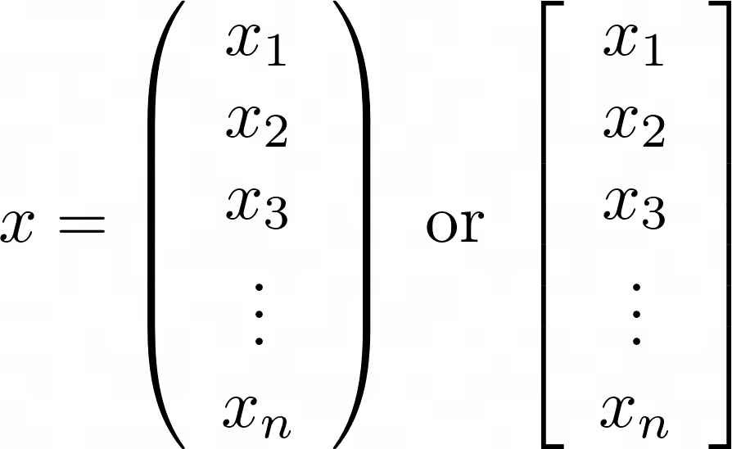
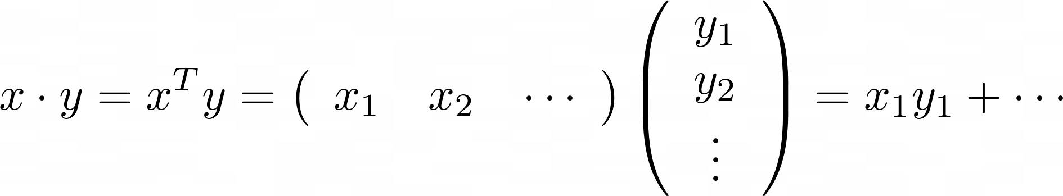
Column vectors:
later in 18.06:
other kinds of “vectors” too!
… matrices and functions
can be “vectors”!
n-component column vector of real ( ℝ) numbers
“in”
or x = [x₁, x₂, …, x_{n}] — note commas
= column vector
basic operations on vectors:
• add x + y, subtract x – y,
• multiply by scalars αx
(lower-case Greek = scalar)
Dot (“inner”) products:
row vector (spaces,
not commas!)
transpose:
columns become rows

Slide 18
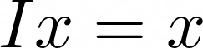
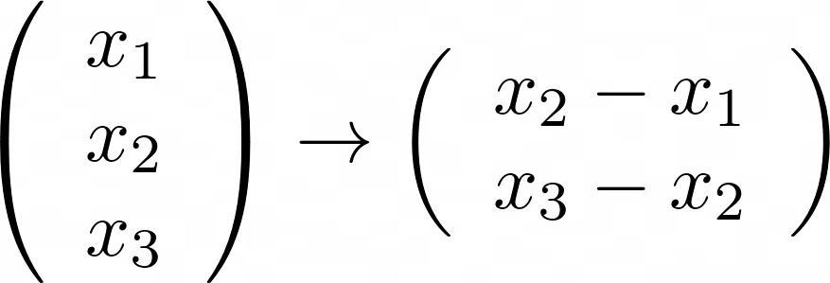
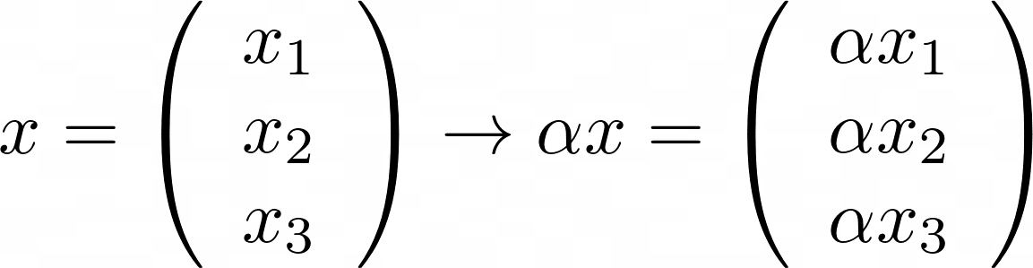
Linear operations on vectors
Linear operations Ax:
take a vector x in and give vector Ax out, satisfying linearity:
A(x + y) = (Ax) + (Ay)
A(2x) = 2(Ax) (or any scalar)
i.e. “distributive law”
A(αx+βy) = α(Ax) + β(Ay)
{
examples:
“linear combination” of x and y
identity operation:
“non-square” operations:
scaling by α:
3 inputs
2 outputs

Slide 19
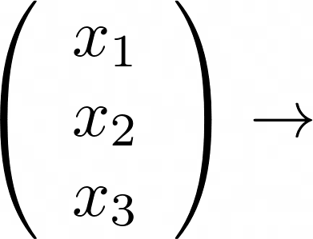
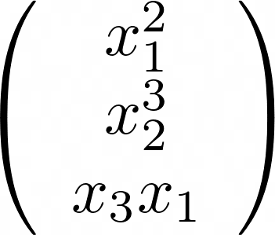
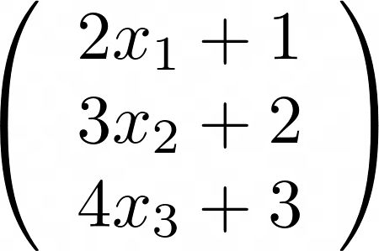
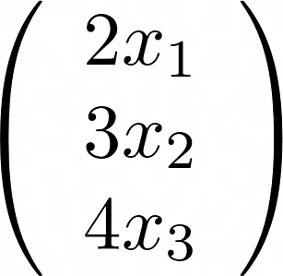
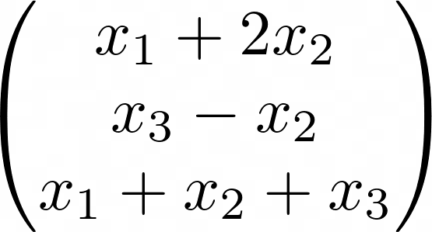
Linear or nonlinear? Examples
x₁
linear
x₁/x₂
nonlinear
nonlinear
nonlinear!
linear linear
nonlinear!
2x₁+1
= linear + constant
“affine”

Slide 20
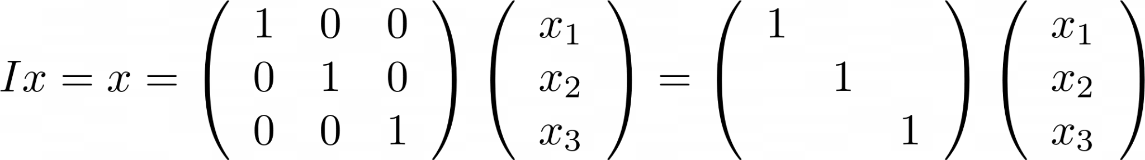
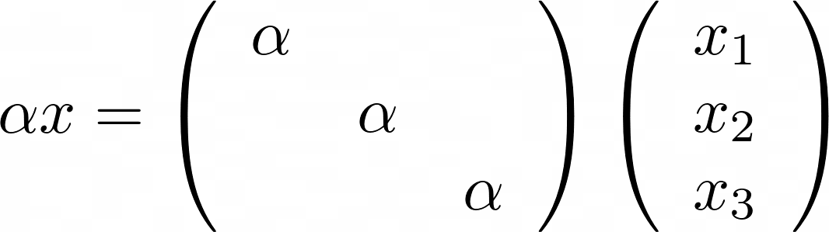
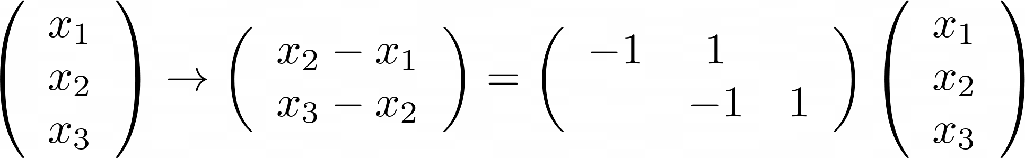
Matrices: Representing linear ops
“rows times columns” rule is just a way of writing down a linear operation
… not always the most natural way!
identity matrix I:
blanks = zeros
scaling by α:
“non-square” operations = rectangular matrices:
2 outputs
2 x 3 matrix
3 inputs

Slide 21
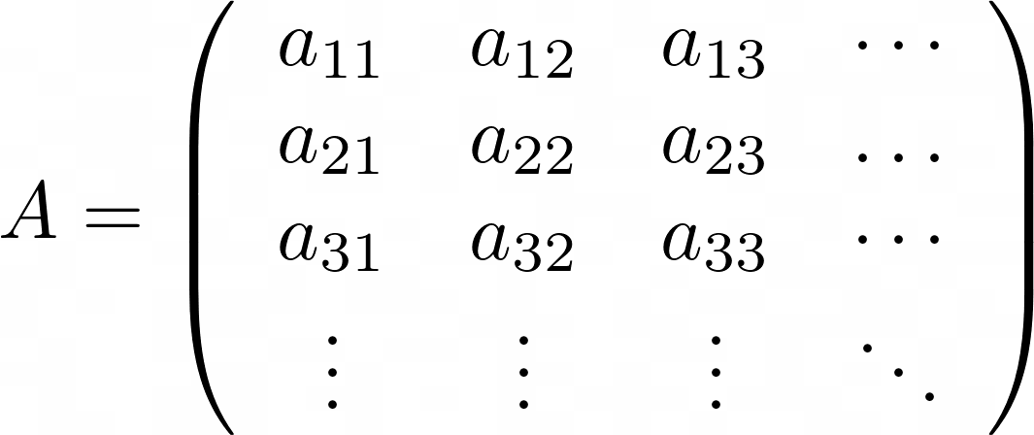
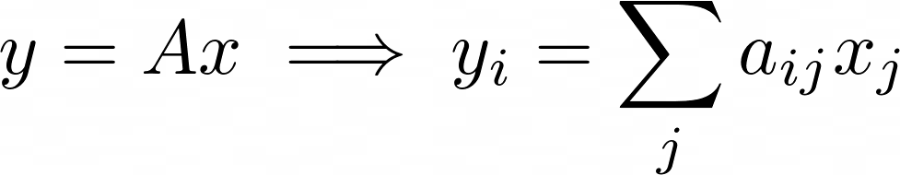
Matrices: Representing linear ops
a_{ij} = row i, column j = output i, input j
( …or sometimes I’ll write A_{ij} )
output i (y_{i})
= “dot product” of
row i of A
with column x

Slide 22
Matrix multiplication = Composition
A(Bx) = take input x, do operation B, then do operation A
= (AB)x where AB = operation that does B, then A
≠ (BA)x or B(Ax) … associative but not commutative
Matrix-multiplication “rows times columns” rule for AB is defined so that associativity works, but always remember that “AB” means “do B, then A” when acting on a vector
We will explore several ways to think about matrix multiplication AB besides mechanical “rows times columns”…
Our goal is not just to mindlessly “turn the crank.”

Slide 23
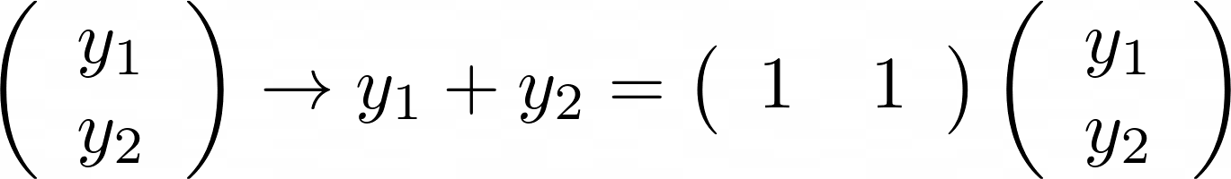
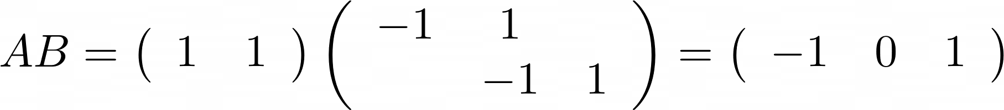
Matrix-multiplication example
2x3 matrix B
“1x2 matrix” A
(really, a row vector)
matrix that
does x₃ – x₁
(1x2)*(2x3)
= sum of 2 rows of B
… whereas BA doesn’t even make sense! A has 1 output, but B has 3 inputs!

Slide 24
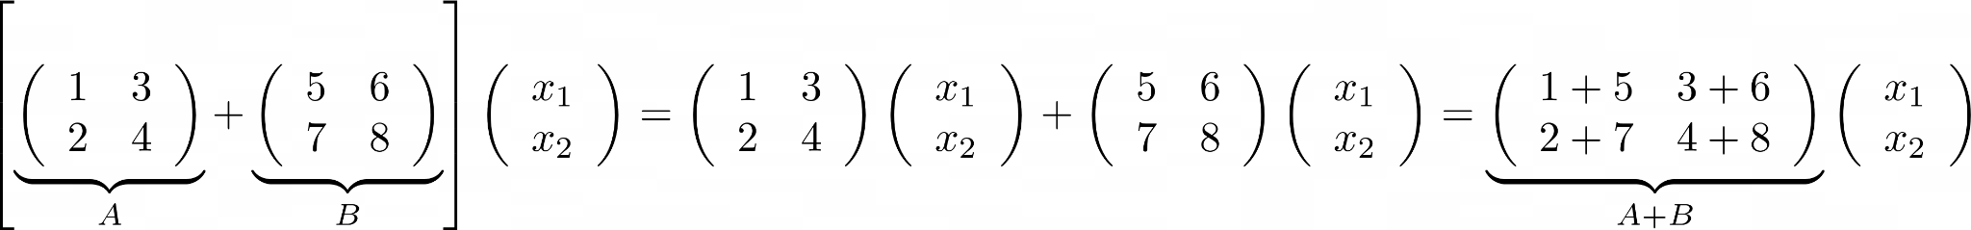
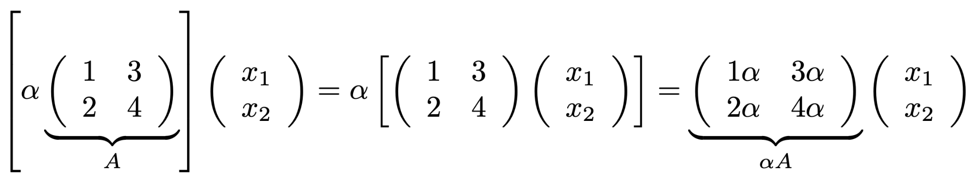

Adding & scaling matrices
What does “A + B” mean for two m × n matrices?
— it means adding the results: (A+B)x = Ax + Bx
— but adding entries of A and B gives the same thing:
What does “αA” mean for a matrix and a scalar?
— it means scaling the results: (αA)x = α(Ax)
— but scaling entries of A gives the same thing:
… so you can add/subtract matrices
& multiply by scalars … sort of like vectors…

